Slide 1
Computer Vision Based Ambulance Detection System
• Real-time ambulance detection using YOLO deep learning model.
• Automatic emergency SMS alert using Twilio Cloud API.
• Designed for intelligent traffic monitoring systems.
• Built using custom trained dataset.
URK23CS5056
MERSHICK J

Slide 2
Identification of Project Title and Domain
Project Title:
Computer Vision Based Ambulance Detection and Emergency SMS Alert System
Domain: Computer Vision & Artificial Intelligence
Sub-Domain: Deep Learning / Real-Time Video Analytics
Application Area: Smart Traffic Management & Emergency Response
Technology Stack:
Python, YOLO, OpenCV, Twilio Cloud API

Slide 3
Problem Statement
In rapidly growing urban areas, traffic congestion has become a major challenge, significantly affecting emergency response systems. Ambulances transporting critical patients often experience delays due to heavy traffic and lack of priority management. Current traffic monitoring systems primarily rely on manual CCTV observation, which does not provide automatic identification of emergency vehicles. The absence of intelligent detection and alert mechanisms results in delayed coordination between traffic authorities and emergency services.
Traditional traffic systems lack automated emergency vehicle recognition and notification mechanisms.
Delays in ambulance movement can increase risk to patients, making intelligent detection systems essential.

Slide 4
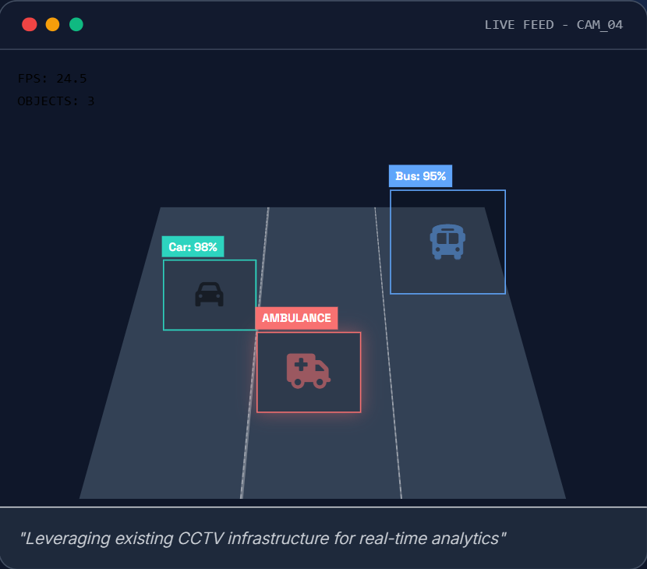
Objectives
• Detect ambulance in real-time video stream.
• Use YOLO object detection model.
• Trigger SMS alert instantly upon detection.
• Reduce emergency response time.
• Demonstrate practical application of Computer Vision.

Slide 5
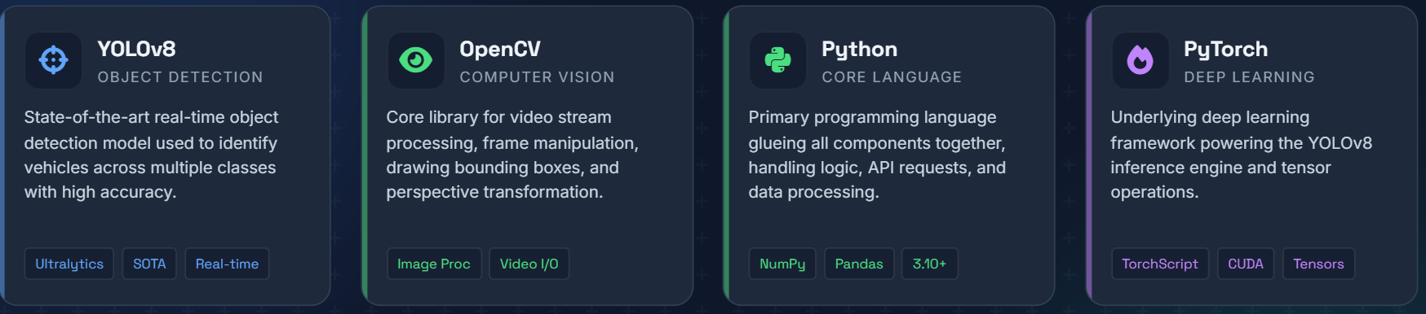
Technologies Used
• Python Programming Language
• YOLO Deep Learning Model
• OpenCV for video processing
• Custom annotated ambulance dataset
• Twilio Cloud API for SMS alerts

Slide 6
Custom Trained Dataset
• Dataset created and annotated manually.
• Bounding boxes drawn around ambulance class.
• Data augmentation applied (flip, brightness, resize).
• Train/Validation/Test split performed before training.
• Model trained using YOLO architecture.

Slide 7
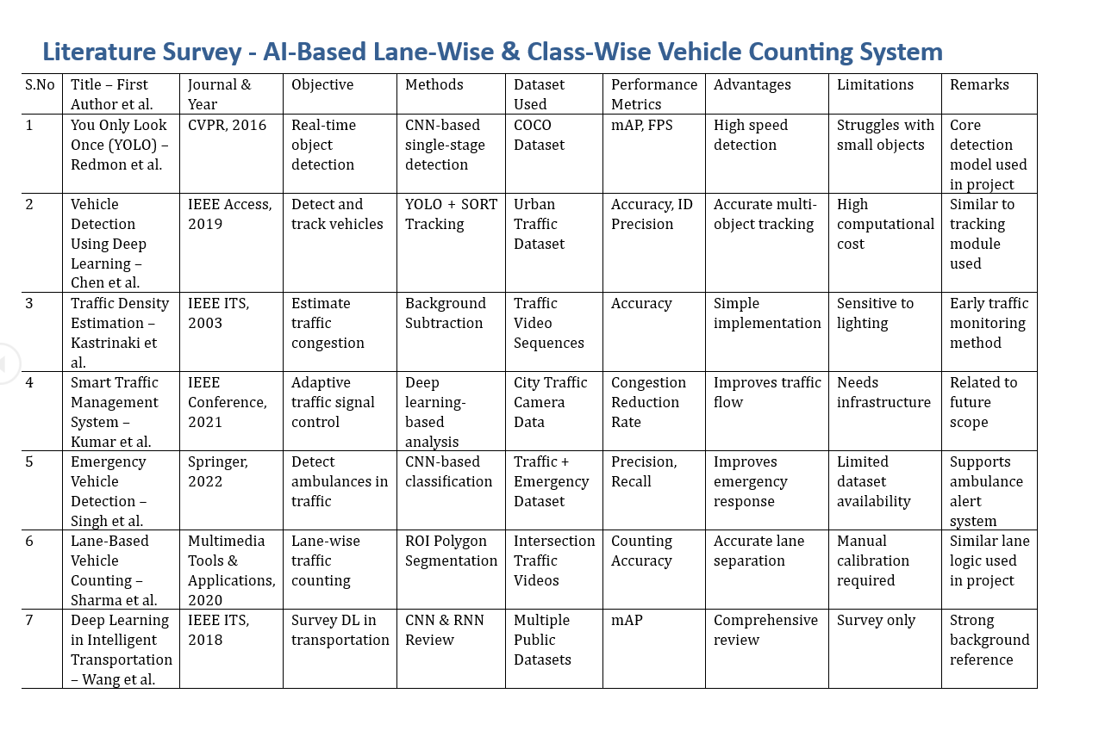
Literature Survey / Background Study

Slide 8
System Architecture
Video Input
YOLO Detection
Ambulance Identified
Twilio SMS Alert

Slide 9
Results
• Accurate ambulance detection achieved.
• Real-time bounding box visualization.
• SMS alert successfully triggered using Twilio.
• System tested on traffic video samples.

